Slide 1

EM-HEALTH 24/7
AN EMERGENCY HEALTH SERVICE APP

Slide 2
Presented By
Syed Fahim Ahmed
Sham-E-Ansari
Sarwar Saif
Fairuz Shezuti Rahman

Slide 3
INTROUCTION
EM-HEALTH 24/7 is an Android based Health care app which provides blood donor information and emergency ambulance service.

Slide 4
Motivation for choosing Health care app
Health care, an important part of human life
Presence of science in human life and health care, to make
life easier
User friendly health care app
For instant health care facility
To handle emergency cases

Slide 5
APP FEATURE
User friendly
Emergency health care service
Blood Bank with proper validation of last donation date
Donor without blood borne diseases
Emergency 24/7 ambulance service
Nearby ambulance indication

Slide 6
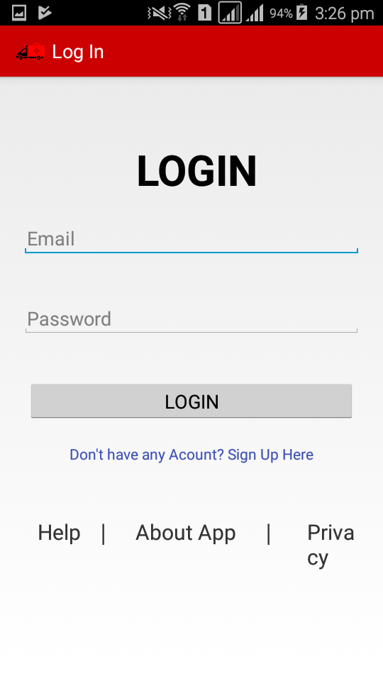
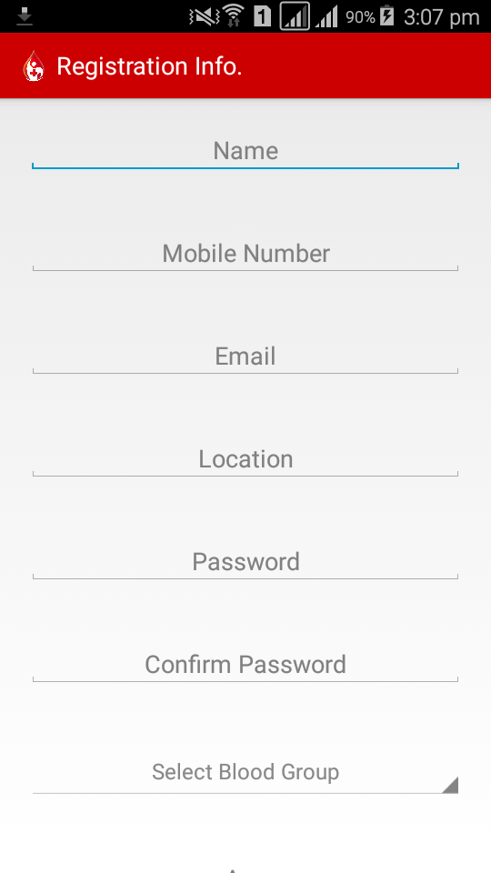
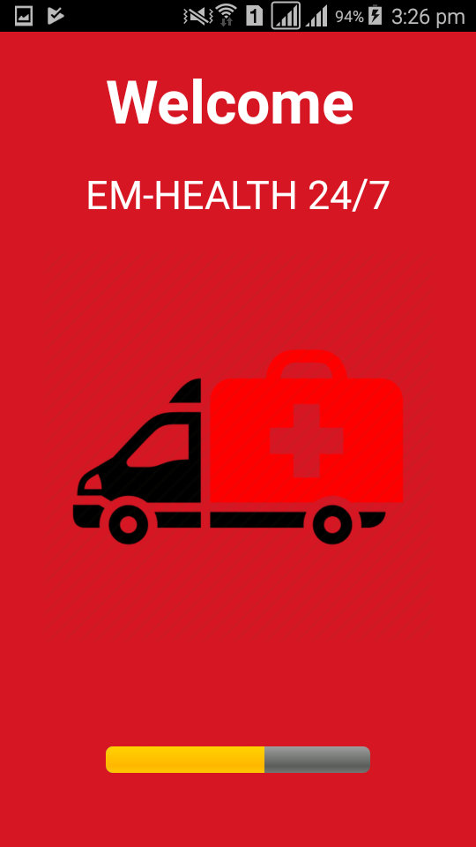
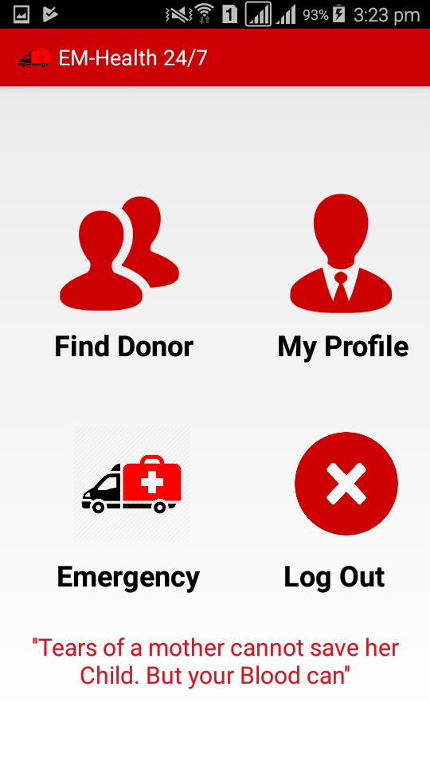
APP REVIEW
User Friendly app starting with registration and login
Takes input of donor information
Easy access for any user with privacy
User information is secure and privacy is maintained
A map is shown for ambulance service

Slide 7
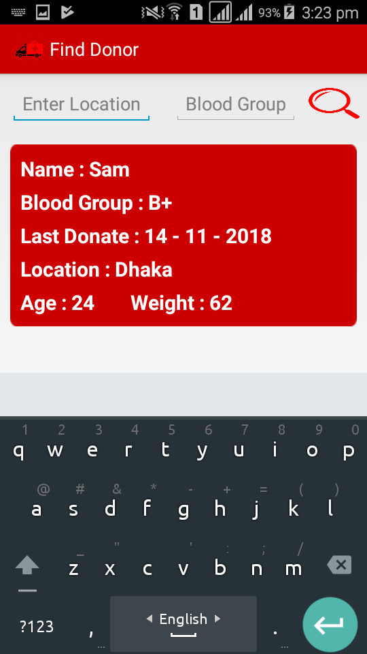
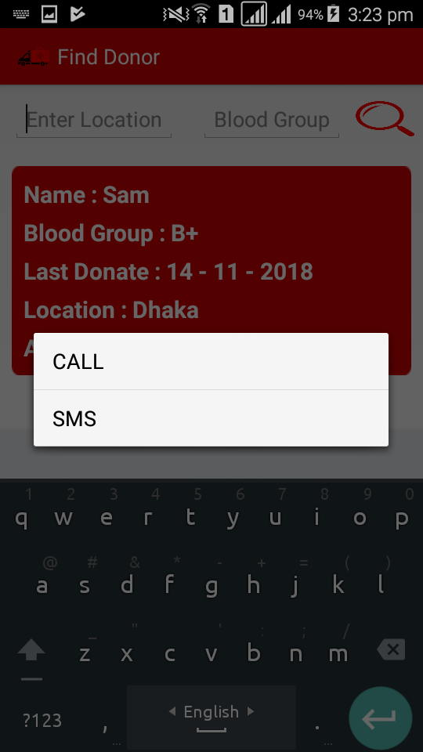
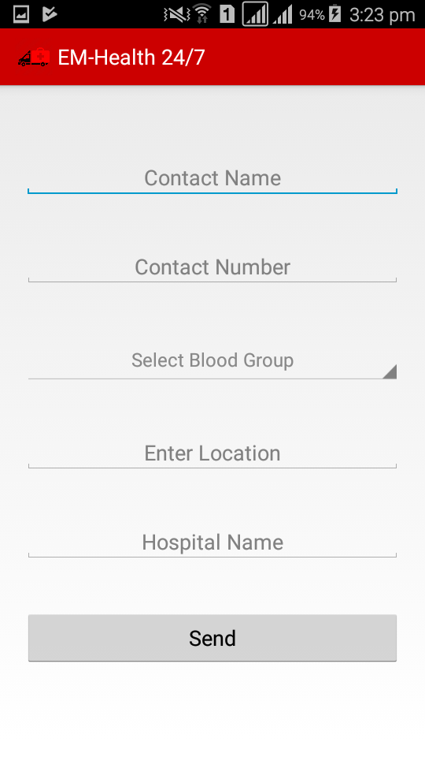
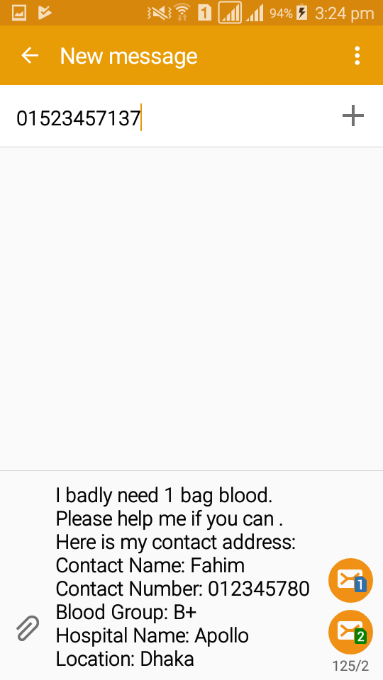
APP REVIEW
User Friendly app starting with registration and login
Takes input of donor information
Easy access for any user with privacy
User information is secure and privacy is maintained
A map is shown for ambulance service

Slide 8
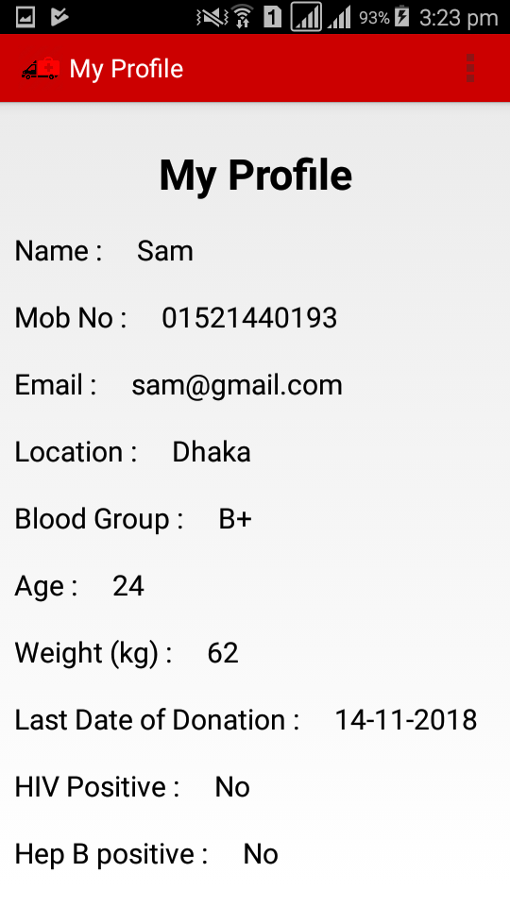
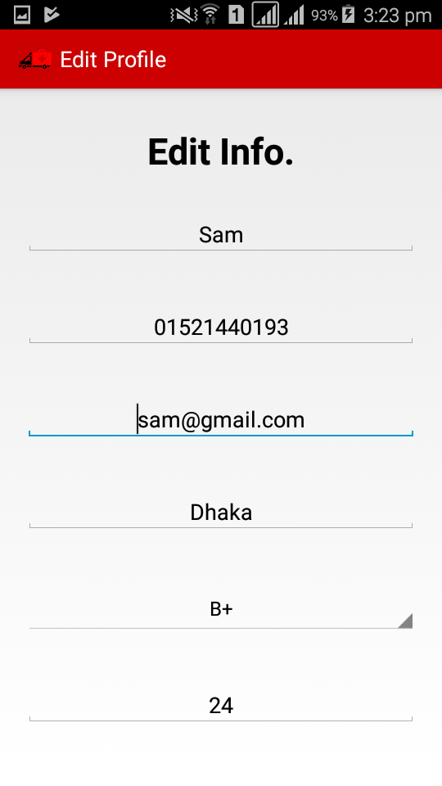
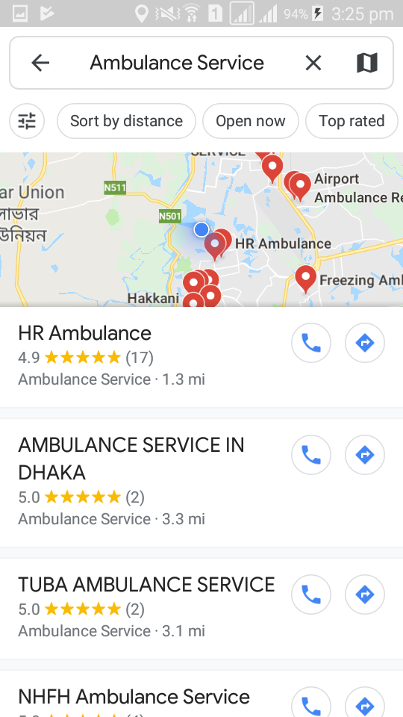
APP REVIEW
User Friendly app starting with registration and login
Takes input of donor information
Easy access for any user with privacy
User information is secure and privacy is maintained
A map is shown for ambulance service

Slide 9
USE CASE
include
Username & password
Login
extend
Show Error Message
Register
extend
Email Verification
include
USER
Search nearby Ambulance
include
User Friendly app starting with registration and login
Takes input of donor information
Easy access for any user with privacy
User information is secure and privacy is maintained
A map is shown for ambulance service
Contact Donor
Donation Time Verification

Slide 10
Future Work
2 layer authentication privacy to secure user information strongly
Personal ambulance service which will provide ambulance service from important point of the area
Forum for organizing blood donation camp
User Friendly app starting with registration and login
Takes input of donor information
Easy access for any user with privacy
User information is secure and privacy is maintained
A map is shown for ambulance service

Slide 11
CONCLUSION
User will get help on emergency basis anytime they want. It’s an user friendly app so that user doesn’t have to face any troubles. Interested user can donate their blood. User can get blood donation in emergencies with nearest location search option. Emergency nearby ambulance service is also provided with this app.
User Friendly app starting with registration and login
Takes input of donor information
Easy access for any user with privacy
User information is secure and privacy is maintained
A map is shown for ambulance service

Slide 12
THANK YOU
User Friendly app starting with registration and login
Takes input of donor information
Easy access for any user with privacy
User information is secure and privacy is maintained
A map is shown for ambulance service

